Slide 1
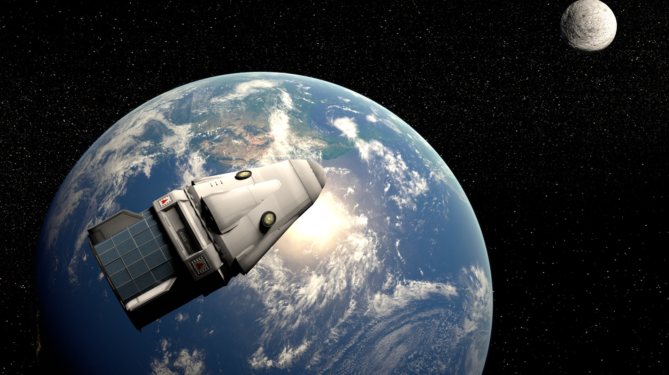
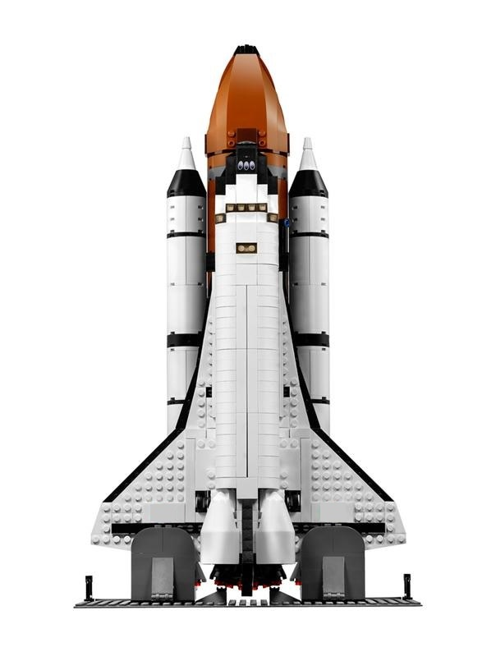
Real-Time Spacecraft Configuration and Monitoring
R Arvind 1OX14CS067
Rakshith Patil 1OX14CS069
S Deepak Raam 1OX14CS074
Sakir Beg 1OX14CS076

Slide 2
Abstract
In the context of spaceflight, a satellite is an object which has been placed into orbit by human endeavour. Satellites are used for a large number of purposes. Common types include military and civilian Earth-observation satellites, communications satellites, navigation satellites, weather-monitoring satellites and scientific research satellites
A satellite consists of various parameters that are meant to be under constant observation. Some of them are listed below:
Total Spacecraft Load
Current
Pressure
Acceleration
Velocity
Temperature
Once the satellite is launched and put into an orbit, monitoring the health condition of the satellite becomes a crucial factor in a space mission. The data that represents the health condition of the satellite is called telemetry data. The satellite transmits the telemetry data to a Ground station. This is known as satellite downlink. The analog data received by the ground station is decompressed, decrypted and converted into digital format. Further the binary data is processed by applying engineering unit conversion scheme specific to a sub-system telemetry parameter and the processed value is generated in real-time.

Slide 3
Objective
The software shall take time-wise samples of processed telemetry parameters as input data and deliver it to a visualization unit in real-time
The software shall have the provision of delivering consecutive samples of each parameter value at every execution for a given parameter.
The software shall have the provision of fetching samples of processed values of a particular telemetry parameter for a given time period.
The software shall have the provision of displaying an error message if any anomaly occurs.
The software shall have the provision of displaying the processed telemetry data in the form of a graph (versus time) in real-time between certain threshold values specific to each telemetry parameter. These thresholds are defined by default.
The software shall have the provision of displaying the processed values of a given telemetry parameter obtained for a desired time period in the form of a graph (versus time period).
The software shall have the provision of altering the threshold values of a telemetry parameter at the user’s discretion. The lower and higher threshold values are taken as input and the real-time graph display is updated with the new threshold values in real-time.
The software shall have the provision of displaying a notification in real-time every time the telemetry parameter value exceeds its threshold. Such a situation must be recognized by the software and an alert must be displayed in real-time independent of the telemetry parameter currently being monitored.
The software shall be portable. It should be executable on any machine meeting the requirements independent of the platform hosted on the machine.
Position
Power & Velocity

Slide 4





Requirements
SOFTWARE
REQUIREMENTS :
HARDWARE REQUIREMENTS :
Software requirements can be specified as follows:
Windows/Linux/Unix operating system
JDK (version 1.8.0_161)
Apache and Tomcat Servers
JavaServer Pages(version2.3)
SQLite (version 3.21.0)
Minimum Hardware Requirements:
2GHz 32 or 64-Bit Processor
2GB RAM
500GB Hard Disk
built-in graphics card (512 MB memory capacity)
USB port, NIC port
18/24 inch monitor
keyboard and mouse

Slide 5
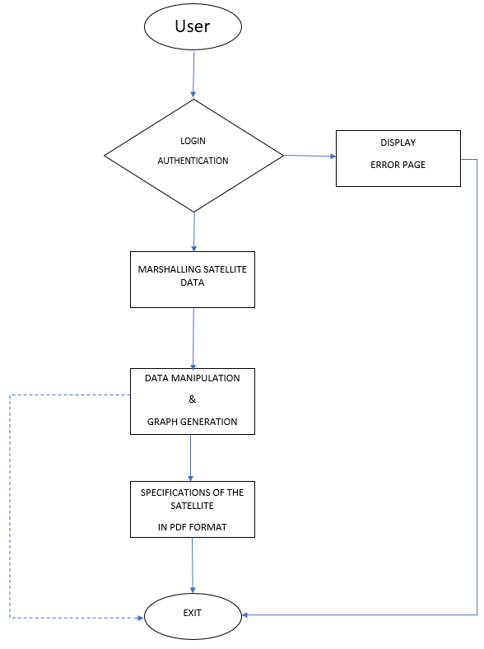
Methodology
It is implemented as web based application using HTML,CSS,JavaScript,JavaServer Pages to create a dynamic user interface to access and manipulate satellite details.
The data from the satellite is retrieved using RMI (Remote Method Invocation) . the Remote Method Invocation (Java RMI) is a Java API that performs remote method invocation, the object-oriented equivalent of remote procedure calls (RPC).
The data collected from the satellite is stored in a database create using SQLite and simultaneously displays the real-time data on the web page.

Slide 6
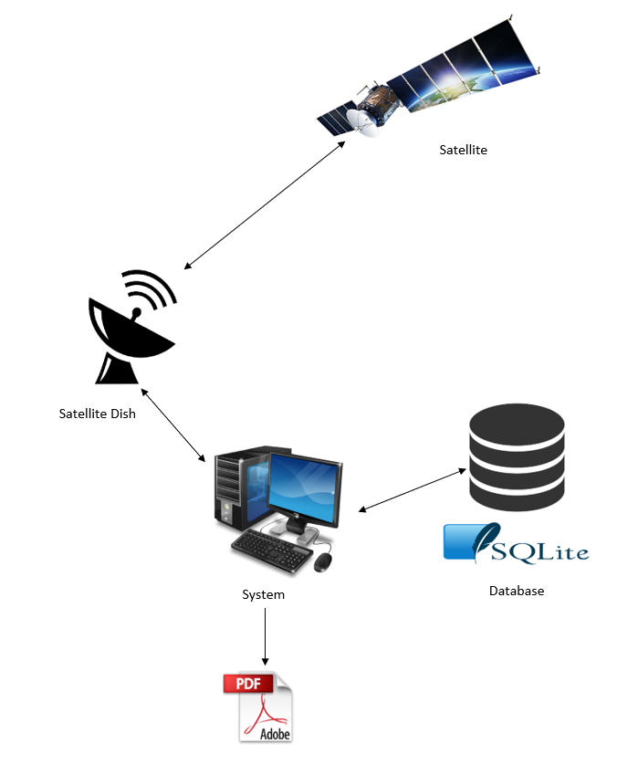
Output
A real-time satellite health monitoring tool is developed that takes real-time input from a satellite and visualizes the data in the form of text and graph and generates a file giving the detailed description of the satellite.
The tool integrates textual display and graph display into a single entity called a visualization window.
The tool is capable of displaying the graph that represents the variation of a desired telemetry parameter between the threshold values.
The tool provides a feature of changing the threshold values of a parameter. The threshold values are updated in real-time.
It is crucial to monitor this telemetry data in real-time and operate the instruments on-board accordingly or take action to correct a telemetry parameter value immediately so as to prevent damage to any sub-system of the satellite and generates any error message.

